Slide 1
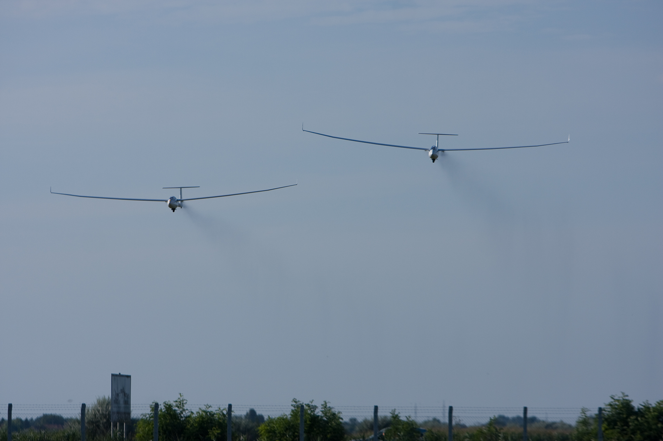
Cross-Country for Beginners Part 5: Flight Computers and Final Glides
Bill Elliott and Rand Baldwin

Slide 2
Tonights Topics
Final Glides (getting to emergency fields)
Flight Computers and what they can do for you
Flight Analysis
Summary

Slide 3
Final Glides
What we really need to know is not “How much altitude to I need to reach an airport?”
What we realy need to know on a continual basis is “What can I reach from where I am now?”
We do too much “estimating” in our heads
This leads to lots of “fudge factors”
Which reduces what think we can do
Limiting what we can do
Which just paralyzes us psychologically!

Slide 4
You ask, “How Far Can I Glide?”
I prefer this calculation which gives glide distance in nautical miles per thousand feet of altitude:
Glide Ratio / 5 = Glide Distance in sm
or, for the Astir CS
35 / 5 = 7 sm, roughly
This comes from:
35 * 1000 ft of Alt = 35,000 ft of Distance
= 35,000 ft / 5,280 ft / sm
= 35 / 5.3 = 6.6 sm
or
= 36/ ~5 = ~ 7sm – easier math!

Slide 5
What about safety margin?
Degrade you best L/D by ~10% (or whatever you like):
so, for something like the Astir
35 – 4 = 31
therefore
31 / 5 = 6 sm
and, for the Blanik
30 – 20% = 24
therefore
24 / 5 = ~5 sm with a 20% margin, so you can get back from Mad Co Lake from 2,600 agl

Slide 6
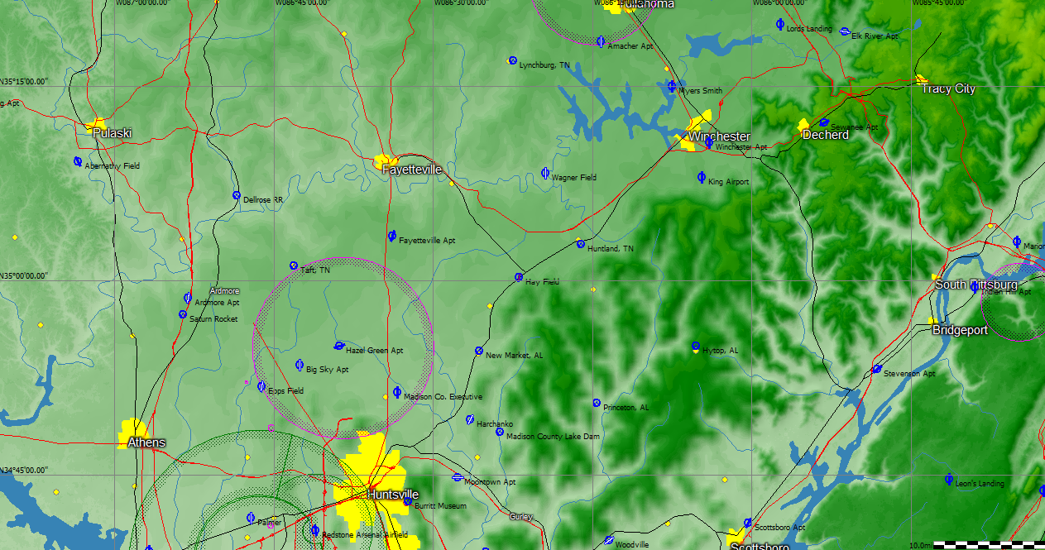
Six Mile Circle
Adding concentric rings

Slide 7
Required Altitude for Best L/D = 30:1
3,000
2,000
30 / 5.28 = 5.68 miles per 1000 ft
or
176 ft per mile , therefore
1,760 per 10 miles.
Given a 1,000 ft pattern plus 500 ft safety
You need ~3,300 ft to go 10 miles.
At 2,500 ft, you can go about six miles.
1,500
1,000
1,000
500 ft
1,000 ft Pattern Altitude
Plus 500 ft Safety Margin
10 miles
8
6
4
2
0

Slide 8
Six Mile Circles
Add more landable fields

Slide 9
Required Altitude for Best L/D = 30:1
3,000
2,000
1,500
Given a 500 ft pattern plus 500 ft safety
You need ~2,800 ft to go 10 miles.
At 2,500 ft, you can go about eight miles.
1,000
1,000
500 ft
500 ft Pattern Altitude
Plus 500 ft Safety Margin
10 miles
8
6
4
2
0

Slide 10
Eight Mile Circles

Slide 11
What if Best L/D more like 35:1?
3,000
Astir CS MC Sink Rate Req’d Alt
No wind 0 1.3 1,430
2,000
1,500
Given a 500 ft pattern plus 500 ft safety
You need ~2,500 ft to go 10 miles.
At 2,500 ft, you can go about ten miles.
1,000
1,000
500 ft
500 ft Pattern Altitude
Plus 500 ft Safety Margin
10 miles
8
6
4
2
0

Slide 12
Ten Mile Circles

Slide 13
What’s the point?
Oh my god … some many circles!
We have been trained to think along these terms:
What is my glide ratio?
How far can I go?
Can I get to an airport or a landable field?
What if the wind quits?
All of this thinking, figuring, analyzing paralyzes us.
We can do better

Slide 14
Why Cruise Faster than Best L/D?
3,000
Astir CS MC Sink Rate Req’d Alt
0 1.3 1,430
No wind 1 1.6 1,510
2 2.1 1,680
3 2.6 1,880
400+ ft
margin
2,000
Maybe you encounter sink.
1,500
MC = 3, Cruise 5 miles, now 250 below glide.
Simple adjust MC = 1 and your back on glide.
1,000
1,000
MC solution is shortest time home.
MC provides altitude “in the bank”.
This MC “bank account” scales with distance.
500 ft
500 ft Pattern Altitude
Plus 500 ft Safety Margin
10 miles
8
6
4
2
0

Slide 15
What about Incorrect Wind?
3,000
Astir CS MC Sink Rate Req’d Alt
0 1.3 1,810
+10 wind 1 1.6 1,830
2 2.1 1,980
3 2.6 2,180
2,000
Was 1,880
1,500
Cruise 4 miles MC = 3, now 250 below glide.
No sense of going through sink, must be the wind.
Adjust the headwind component in Flight Computer.
1,000
1,000
Now adjust MC = 2 and your back on glide.
Not all flight computers get the wind right,
but off by 10 knots is a huge error and is unlikely.
500 ft
10 miles
8
6
4
2
0

Slide 16
Now what’s the point?
Oh my god … some many glide slope lines … and sink … and wind errors!
Now how do we do all that figuring for:
What is my glide ratio?
How far can I go?
Can I get to an airport or a landable field?
What if the wind quits?
You don’t, that’s the point, you get a flight computer.
And … you learn to use and learn to believe it!

Slide 17
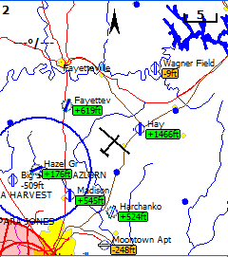
What if you had a Flight Computer
Your in the Astir
Your at 2,600 ft
Location is known
Performance known
Wind known
Airports known
Landable fields known
Wow! You know a lot!
Sense of paralysis is gone!

Slide 18
Let’s talk Flight Computers
You need one, period.
What kind you get is up to you and your budget.
Let’s go over some Pro’s and Con’s for:
Low Cost Systems
Medium Cost Systems
High End Systems

Slide 19
PDA and PNA based Systems
Pros
High speed processor
Graphical display
Color
Touchscreen
Rapid technology upgrades
Wide variety of software available
Free Software development tools
Cons
Screens not as easy to read as in panel displays in sunlight
Depending on mounting solution, can get in the way of view out canopy or block access to controls
Internal Batteries won’t last when communicating with a GPS, so a 5 V power converter is required (some instruments provide 5 V)

Slide 20
Glide Navigator II
Pocket PC
Programmers: Chip Garner, Rich Herr
Marketing and Support: Paul Remde
$200
Designed for ease-of-use in flight
Big “finger sized” buttons and large display text
Simple, uncluttered map display – only the information you need to fly your task
Easiest to learn for a non-technical person
Popular

Slide 21
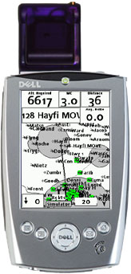
Low Cost Systems
Components
Pocket PC or Palm OS PDA
GPS
Cables and Power Supply for PDA (5 V) and GPS (12 V or 3.3 V)
$290 to $1200
Example Systems
Glide Navigator II on Dell Axim X5 with Transplant CF Card GPS
Any soaring flight software on any PDA
GPS Types
CF Card
SDIO GPS
“Puck” style
BlueTooth GPS
Garmin or similar

Slide 22
What Low Cost Systems Can Do
Use GPS Position and Altitude
Moving Map with Waypoints and SUA
Final Glide Calculations
Reachable Airports Highlighted
Record Unofficial IGC flight logs
Tasks
Portable (suction cup mount)
No cables (depending on GPS)
Flight Statistics
GPS altitude used for final glide (not best)
OK for some contests?
Improved safety through quick access to final glide data
Wind speed and direction calculated using drift while circling
90% of what the high cost systems can do

Slide 23
What Low Cost Systems Can’t Do
No Pressure Altitude Data
No IGC Approved flight log for badges and records
No Vario or averager
No Speed-to-fly
Can’t calculate wind speed and direction using airspeed and GPS data while cruising
When used with a speed-to-fly vario you must enter MacCready into both devices

Slide 24
Low Cost Systems
Components
Pocket PC or Palm OS PDA
GPS
Cables and Power Supply for PDA (5 V) and GPS (12 V or 3.3 V)
$290 to $1200
Example Systems
Glide Navigator II on Dell Axim X5 with Transplant CF Card GPS
Any soaring flight software on any PDA
GPS Types
CF Card
SDIO GPS
“Puck” style
BlueTooth GPS
Garmin or similar

Slide 25
What Medium Cost Systems Can Do
Use GPS Position and Pressure Altitude
Moving Map with Waypoints and SUA
Final Glide Calculations
Reachable Airports Highlighted
Record IGC Approved flight logs
OK for all contests, badges, and records
Tasks
Flight Statistics
Improved safety through quick access to final glide data
Wind speed and direction calculated using drift while circling
Portable - maybe
92% of what the high cost systems can do

Slide 26
What Medium Cost Systems Can’t Do
No Vario or averager
Minimal Speed-to-fly
Can’t calculate wind speed and direction using airspeed and GPS data while cruising
When used with a speed-to-fly vario you must enter MacCready into both devices

Slide 27
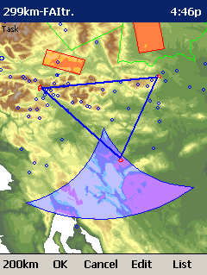
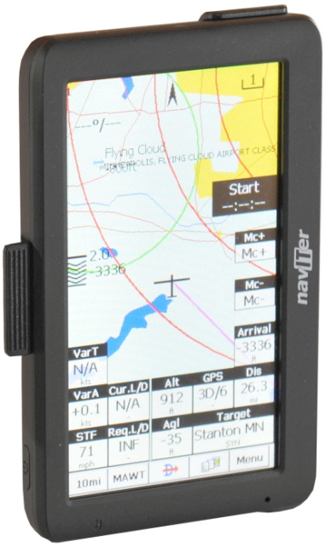
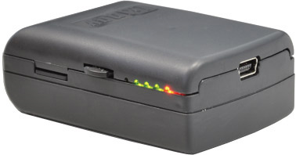
SeeYou Mobile and LX Nano
Oudie with internal GPS
Price: $650
Moving map very configurable
Statistics pages
Thermal history page
Topographical maps – same maps used in SeeYou for PC
Shaded area for FAI triangles
Online Contest competition calculation in flight
Need an IGC-approved GPS/ logger
No variometer

Slide 28
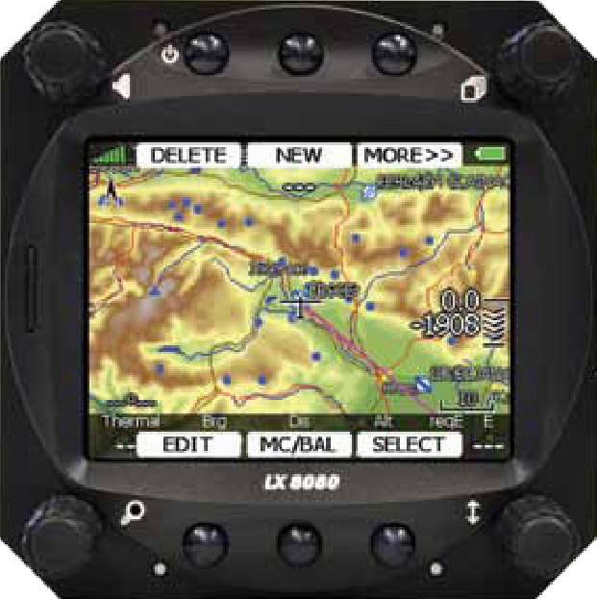
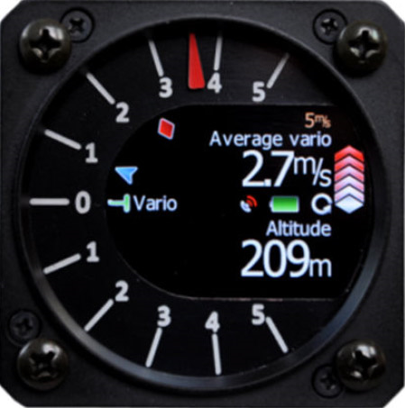
High End Systems
Components
Vario with audio and averager
IGC Approved Flight Recorder with GPS
LCD Display in instrument panel, or PDA
$3000 to $5000
Example Systems
CAI 302 plus Glide Navigator II
ClearNav plus Vario and logger
ILEC SN-10 with vario plus GPS logger
LX8000 with vario and logger
Zander with vario and logger

Slide 29
What High End Systems Can Do
Vario with Audio and Averager
Speed-to-fly director
Wind speed and direction calculated using airspeed and GPS data while circling or cruising
Use GPS Position and Pressure Altitude
Moving Map with Waypoints and SUA
Final Glide Calculations
Reachable Airports Highlighted
Record IGC Approved flight logs
OK for all contests, badges, and records
Tasks
Flight Statistics
Improved safety through quick access to final glide data
MacCready only entered once on vario or PDA and data shared between devices

Slide 30
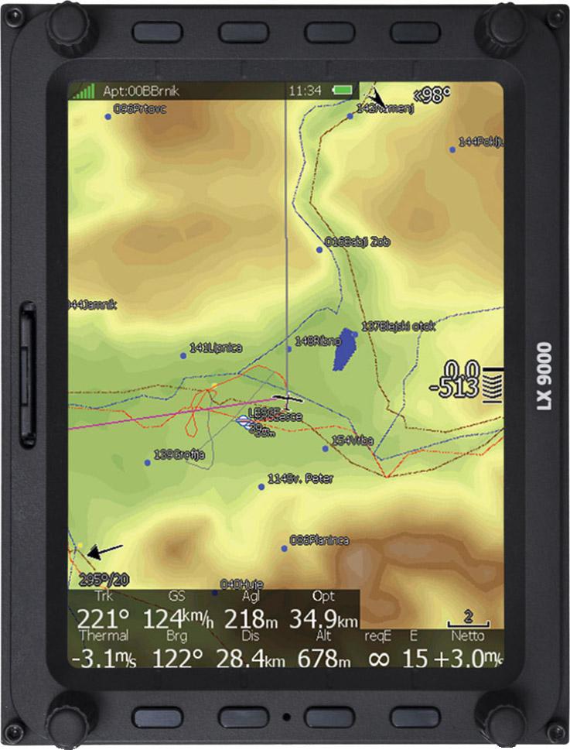
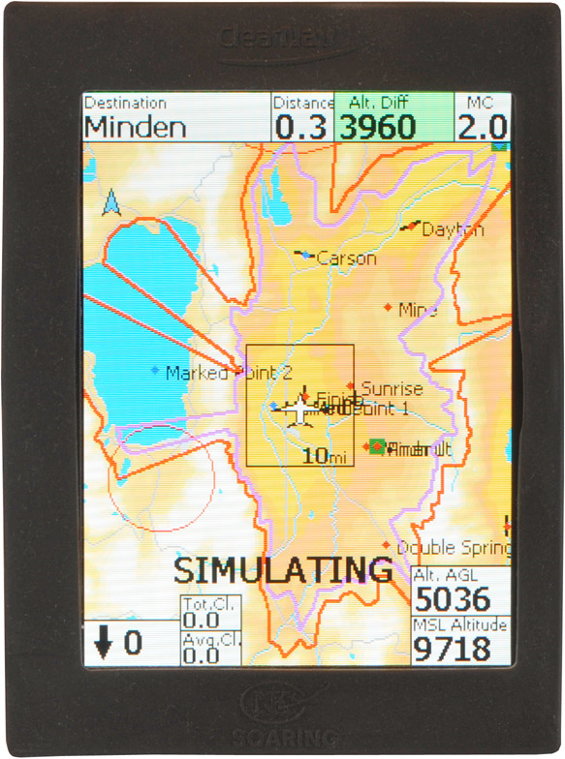
What High End Systems Can’t Do
Not much …
But, they are expensive!

Slide 31
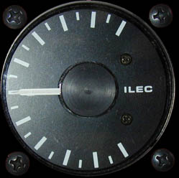
Example High End Systems
Unique Features
Exclusive Thermal Height-Band Graph
No PDA required
Landing fields on map screen in new version this spring
absolute minimal heads-down time
the best wind measurement system flying (with graphic wind arrow)
the best vario available with excellent (non-irritating) audio
quick, intuitive information presentations
pilot-friendly controls (left-hand remote doesn't interfere with flying)
concise moving-map display of task and airspace
very high-contrast display with minimal clutter
painless final-glides around turnpoints (with accurate remaining-time-til-finish)
custom page
reliable software, hardware, and manufacturer - NO SOFTWARE CRASHES
usable in flight, not just your living room
Ilec SN-10B - $2295
LX Nano - $890
Cable - $45
Total: $3230

Slide 32
Flight Analysis
Buy SeeYou … everyone uses it so you can get help and it integrates with SYM
Analyze your flights, every flight.
Do like we did and look carefully at your climbs and your glides
Then, look closely at the barogram
What do the climbs look like?
Climb should be steady, no rollover to the right.
Look at how you exit, no rounded tops
Look at you use of the heightband
What does the cruise look like?
Finally, look closely at the stat.
Average climb rate and percent time climbing
Number of tries
Average cruise length and at what avg IAS
Time in rising air vs sinking air
Avg L/D achieved

Slide 33
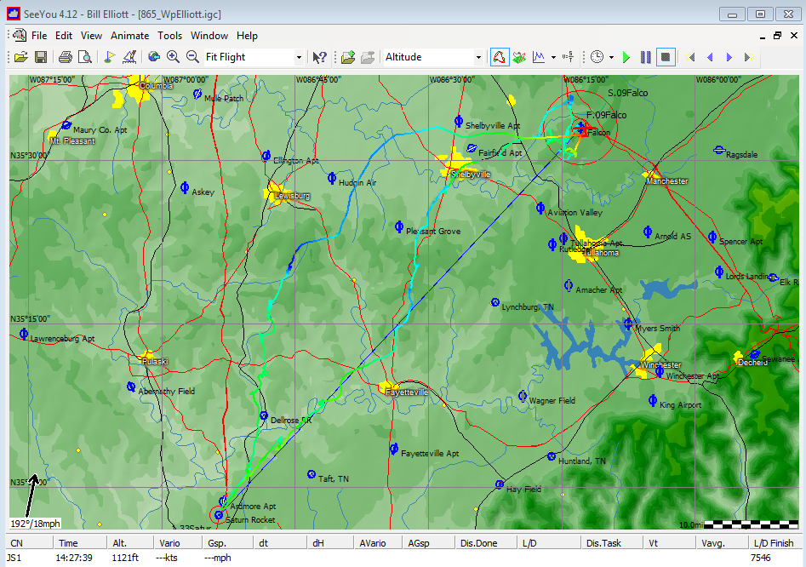

Slide 34
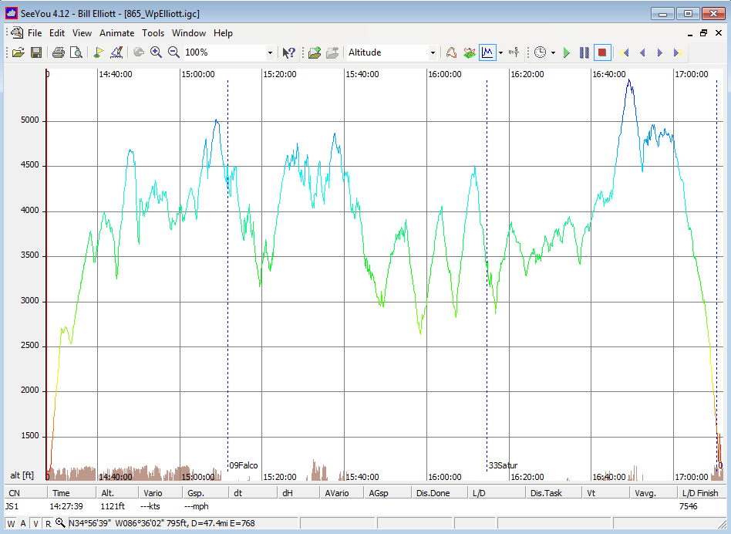
Rounded Top
Rollover
Huh?

Slide 35
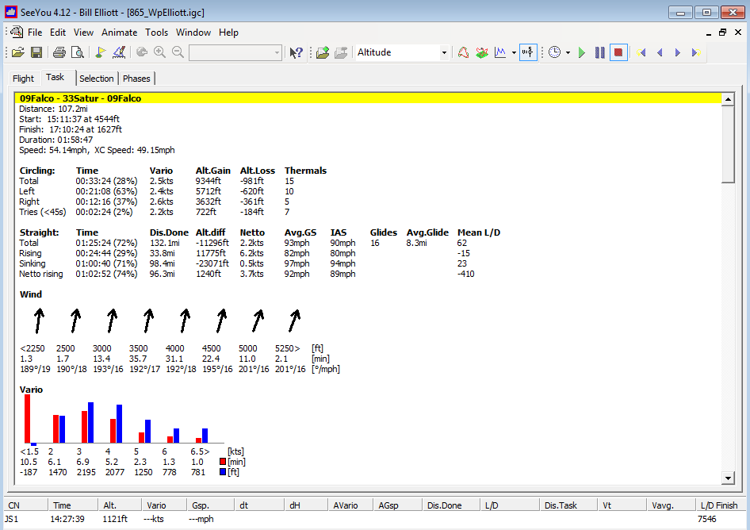

Slide 36
Let’s look at this trace …

Slide 37
That’s all folks!
Let’s start planning the leader-follower flying sessions.

